Slide 1
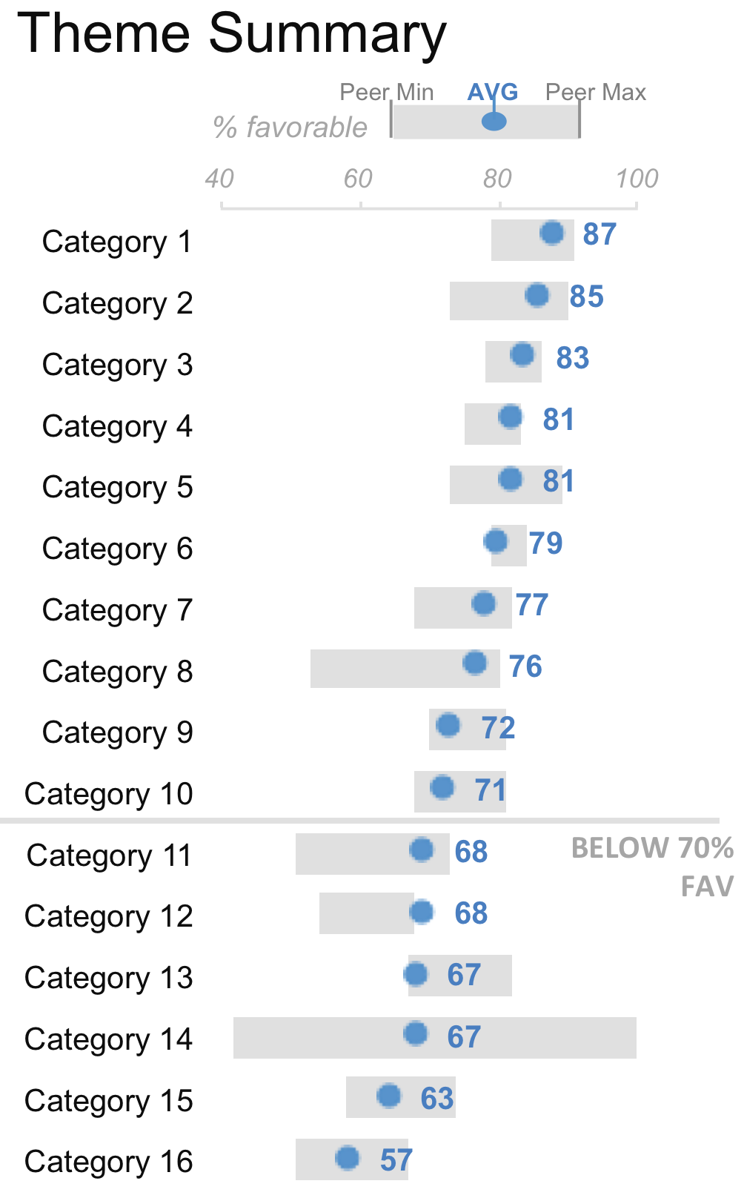
Our team scores mostly more favorable than peers; Category 16 is area of concern, action should be taken
The graph at the right shows theme scores for our team compared to the range of theme scores for our peer group.*
Observations:
❶ Our team scores below 70% favorable on 6 themes, however they are middle-of-the-pack to more satisfied than other similar groups in all but one of these: Category 13
❷ Our team scores low (within 2 points of the minimum) relative to peer groups in 3 themes:
Category 6: add relevant context & details
Category 9: add relevant context + details
Category 13: add relevant context + details
❸ Our team’s category 16 score is concerning: add relevant context + details
*Peer group = xxx
❷
❷
❶
❷
❸
Source: xxxxx

